Slide 1
eBooks & Accessibility
https://bit.ly/ebooksA11y
\

Slide 2
The State of (E)Reading
72% of U.S. adults have read a book in the last year (2019).
27% of U.S. adults haven’t read a book in any format in the last year.
Those numbers haven’t changed much since 2011.
Notes:
Since 2011 when data first collected
https://www.pewresearch.org/fact-tank/2019/09/25/one-in-five-americans-now-listen-to-audiobooks/
https://www.pewresearch.org/internet/2016/09/01/book-reading-2016/

Slide 3
Reading Formats
37% of adults read only print books.
28% of adults read both print and digital (eBooks and audio books).
7% adults read only digital books.
Notes:
Since 2011 when data first collected
https://www.pewresearch.org/fact-tank/2019/09/25/one-in-five-americans-now-listen-to-audiobooks/
https://www.pewresearch.org/internet/2016/09/01/book-reading-2016/

Slide 4
Reading Formats
Formats people have used for reading in the last year (2019):
65% have read a print book –08%
25% have read an eBook +11%
20% have read an audiobook +14%
Notes:
Since 2011 when data first collected
https://www.pewresearch.org/fact-tank/2019/09/25/one-in-five-americans-now-listen-to-audiobooks/
https://www.pewresearch.org/internet/2016/09/01/book-reading-2016/

Slide 5
E-Reading Devices
Digital formats U.S. adults have used to read books (2016):
15% read on a tablet computer +11%
8% read on a dedicated eBook reader –01%
13% read on a cellphone +08%
11% read on a desktop or laptop computer +08%
Notes:
Since 2011 when data first collected
https://www.pewresearch.org/fact-tank/2019/09/25/one-in-five-americans-now-listen-to-audiobooks/
https://www.pewresearch.org/internet/2016/09/01/book-reading-2016/

Slide 6
Conclusions
Print books continue to be more popular than eBooks and audiobooks.
Most readers of digital formats also read print books. It’s not either/or, but both-and.
Interest in digital book formats continues to grow, with audiobooks growing a little faster the eBooks.
The share of readers on tablets or cellphones has increased substantially since 2011, while the share using dedicated e-readers has remained more or less stable.
Notes:
Since 2011 when data first collected
https://www.pewresearch.org/fact-tank/2019/09/25/one-in-five-americans-now-listen-to-audiobooks/
https://www.pewresearch.org/internet/2016/09/01/book-reading-2016/

Slide 7
What is an Ebook?
The vast majority of eBooks that people actually read on digital devices are in one of a handful of formats.
EPUB (2.0, 3.0)
Mobi (AZW, AZW3)
iBook (IBA)
and, okay, PDF

Slide 8
EPUB Characteristics
EPUB
Re-Flowable text
Reader controls font style and size
Swipe for page turn
Image positioning difficult
PDF
Text doesn’t re-flow when enlarged
Usually fixed font style and size
Vertical scrolling for page turn
Exact image positioning

Slide 9
Fixed Layout Epubs
Image-rich books, comics, kids books, text books with interactivity, etc.
More like PDFs
Specify where lines break (poems, captions stay with images)
Text is still live, searchable, selectable, and can be superimposed over images
Control image positioning
Narration or Ambient Audio
Read Along
Interactivity with scripts

Slide 10
Fluid Layout epubs
more accessible than print
Mitigates print disability
Ability to change text size (visual impairment)
Ability to specify font (dyslexia)
Machine-readable (low vision, blindness, learning disabilities)
Screen readers (can supplement visual for low vision users)
Can be converted to braille, audio, etc.

Slide 11
epub 3.0
More accessible than EPUB 2.0
Better Semantics (HTML5)
ARIA Roles for more precise descriptions of content.
MathML
Audio/video media capabilities
Synchronized audio

Slide 12
Cracking Open
your EPUB
On a PC
Change .epub to .zip
On a Mac
eCanCrusher

Slide 13
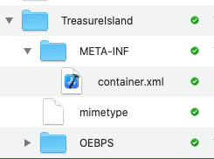
Anatomy of an epub

Slide 14
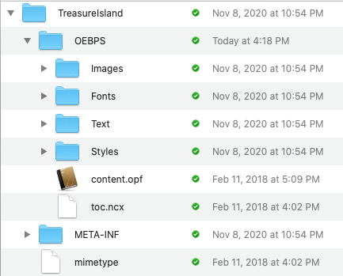
OEBS: The Book Folder

Slide 15
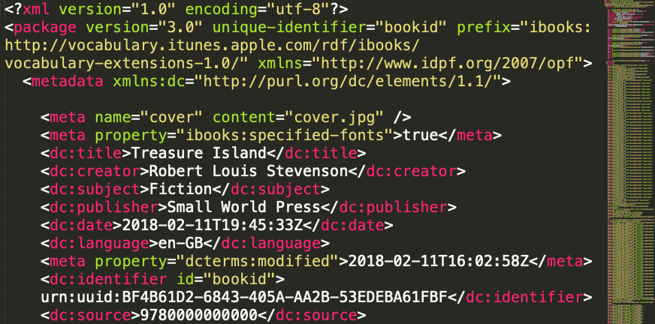
content.opf

Slide 16
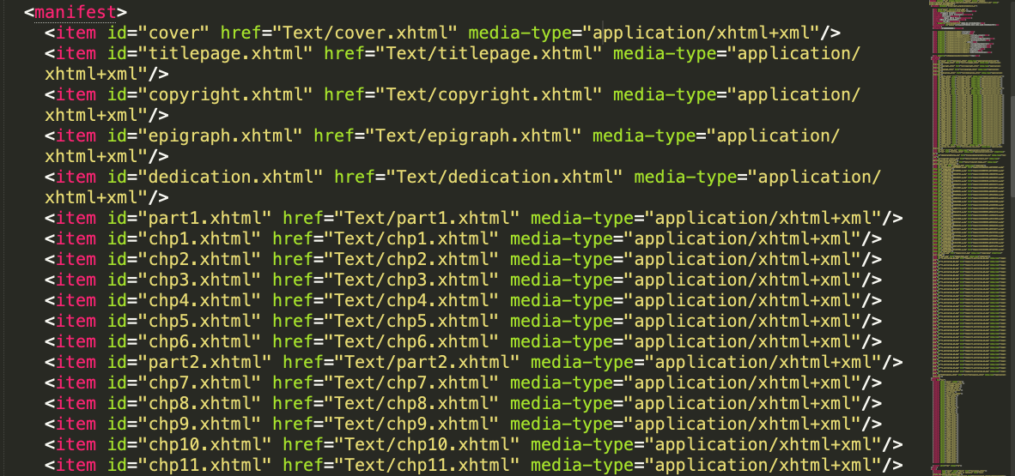
Manifest

Slide 17
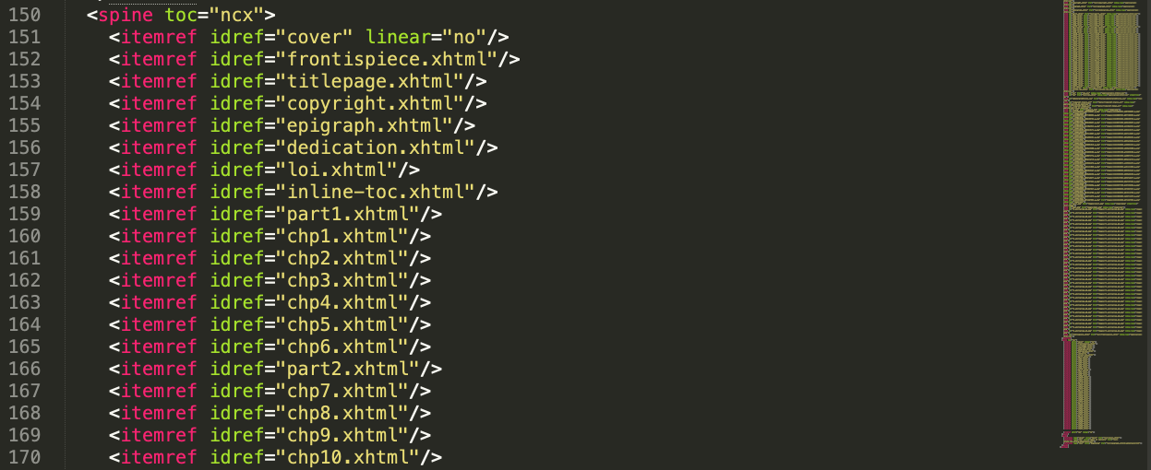
Spine

Slide 18
Guide

Slide 19
Accessibility Metadata
Notes:
schema.org metadata,
https://schema.org/Book
accessMode

Slide 20
accessMode
textual — contains text content
visual — contains visual content such as images, graphics, diagrams, animations, and video
auditory — contains auditory content, such as standalone audio clips and audio soundtracks for video content
tactile — contains tactile content such as embedded braille and tactile diagrams.

Slide 21
accessibilityFeature
alternativeText
audioDescription
braille
captions
resizeText
signLanguage
displayTransformability
structuralNavigation
highContrast
structuralNavigation
transcript
longDescription
Notes:
https://www.w3.org/wiki/WebSchemas/Accessibility
daisy

Slide 22
accessibilityHazard
Flashing
Motion simulation
Sound

Slide 23
accessibilitySummary
“This publication conforms to the EPUB Accessibility at WCAG Level”
“Short descriptions provided, but no long descriptions”

Slide 24
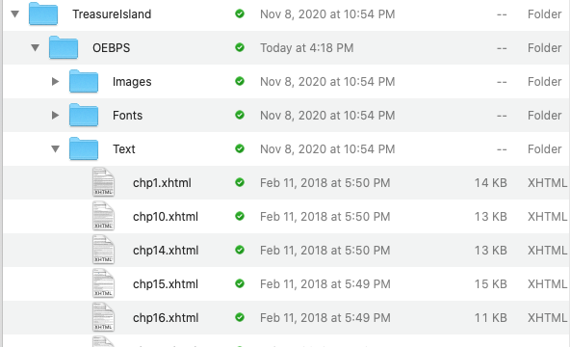
Content FIles

Slide 25
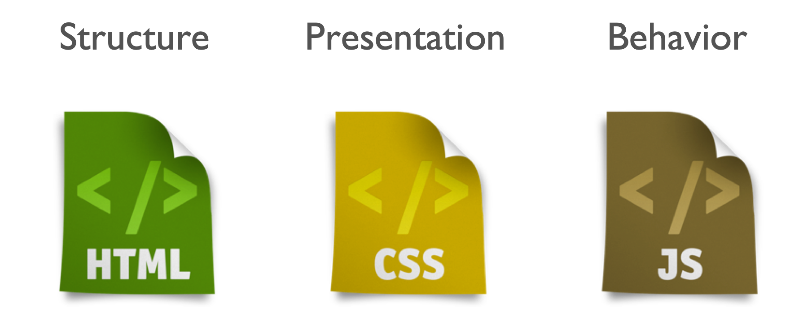
Three Categories

Slide 26
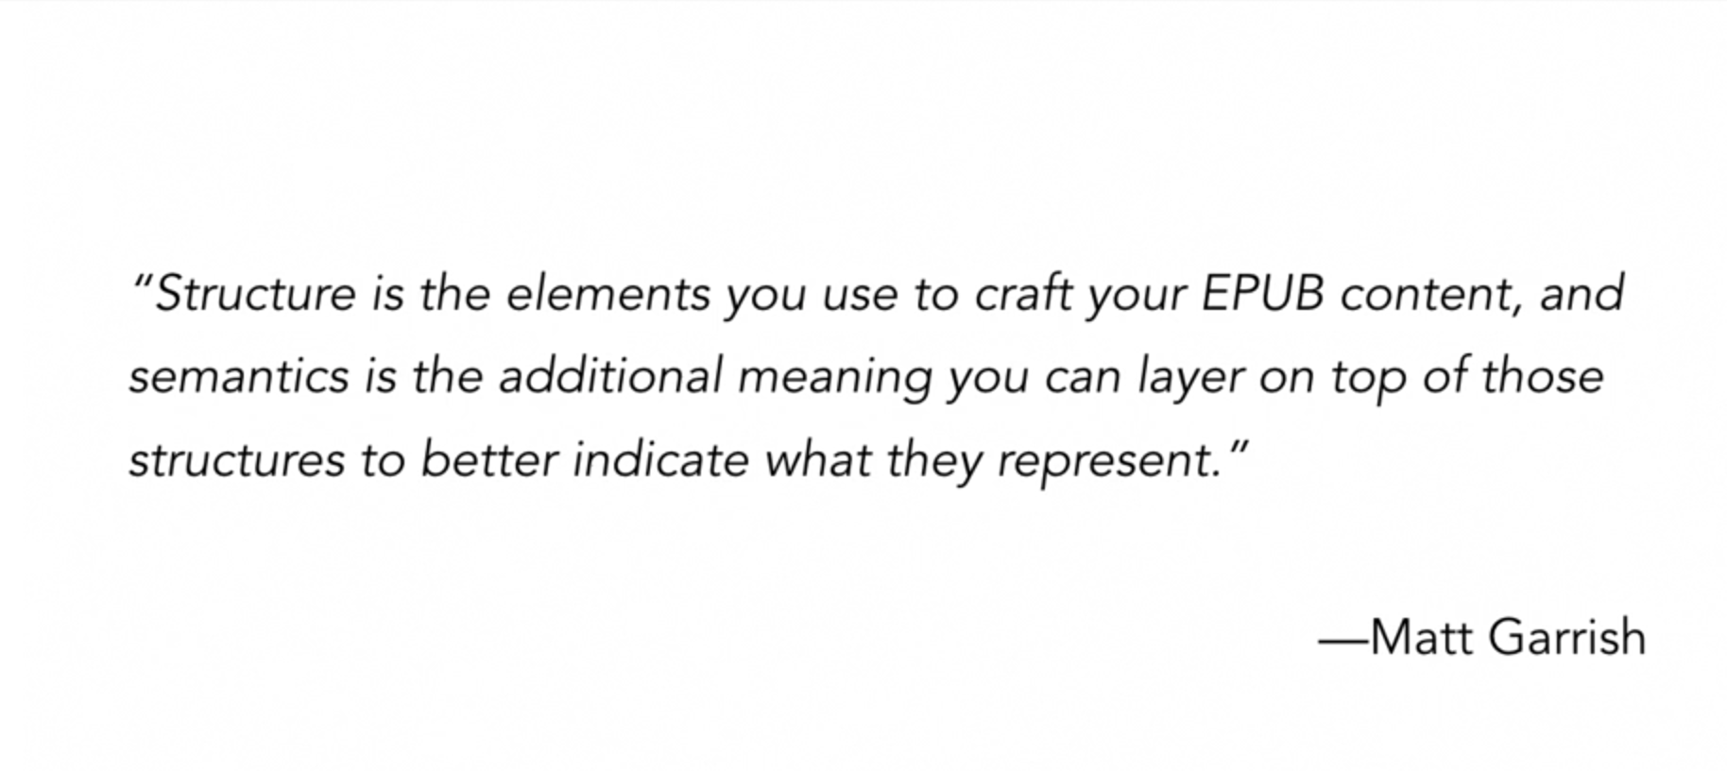
Structure & Semantics

Slide 27
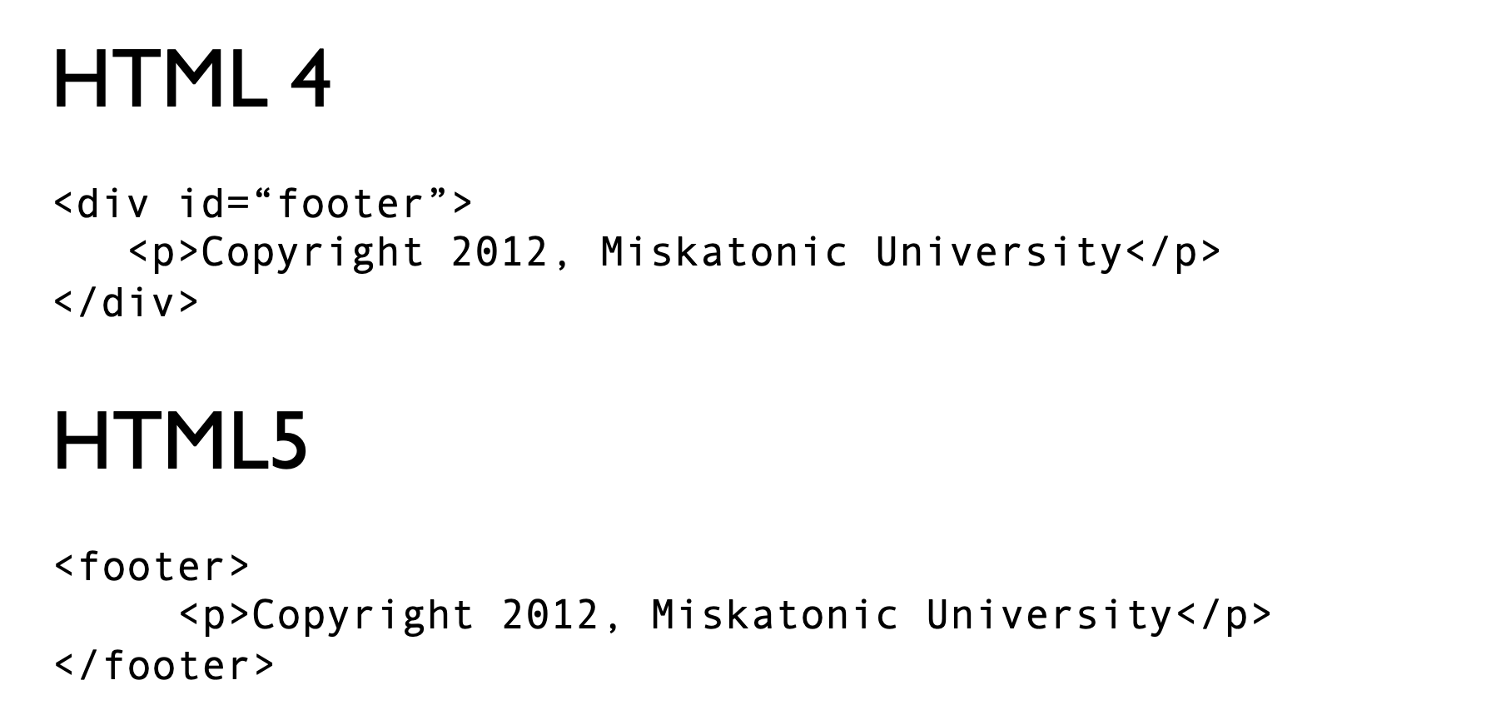
more meaningful Markup
Notes:
Help identify and section content. Meaningful semantic markup

Slide 28
Structural tags
<section>
<nav>
<aside>
<header>
<hgroup>

Slide 29
Aria Roles
ARIA role attributes apply more precise meaning to generic HTML tags.
Define chunks of content, adding a layer of additional meaning.
Help assistive technologies to navigate document by identifying regions and providing landmarks.

Slide 30
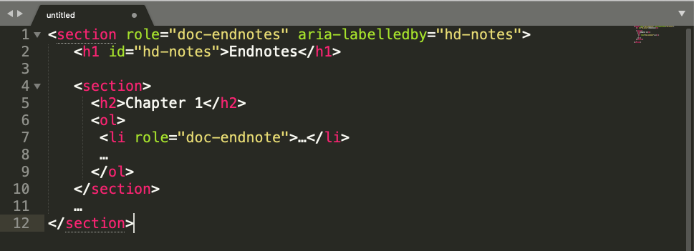
Aria for epubs

Slide 31
Tag Choice

Slide 32
Tag Choice

Slide 33
Tag Choice
Notes:
https://www.w3.org/International/questions/qa-html-language-declarations
http://www.iana.org/assignments/language-subtag-registry/language-subtag-registry
in content.opf still en-GB or en-US

Slide 34
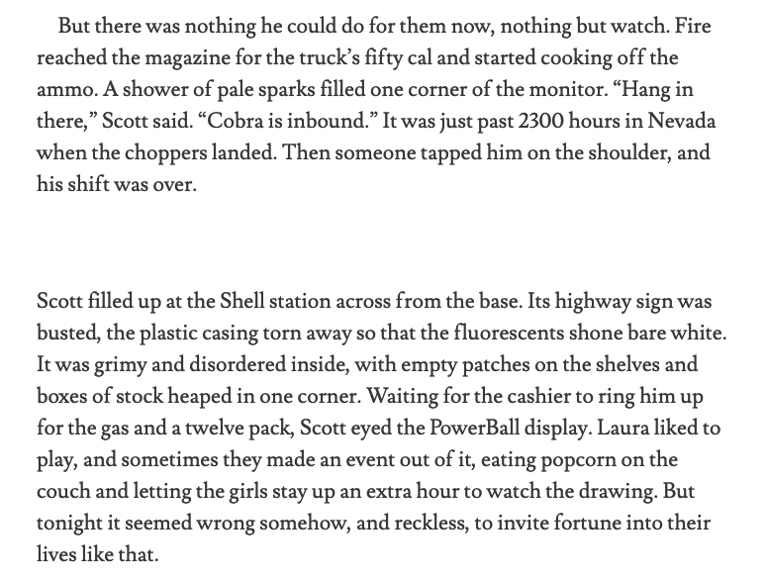
Breaks

Slide 35
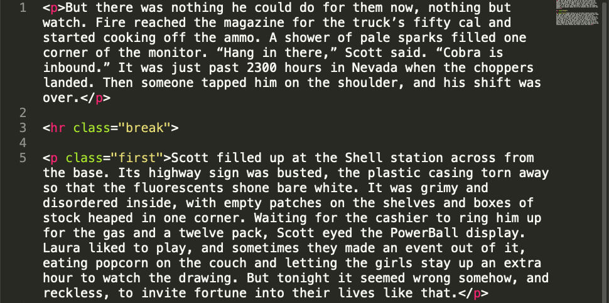
Coding Breaks

Slide 36
Accessible Images
Describe your images
Avoid repetition
Appropriate to reading level
Be concise
Be objective
Start general, go to specific
Do not describe purely decorative images.
<img alt=“” role=“presentation”>

Slide 37
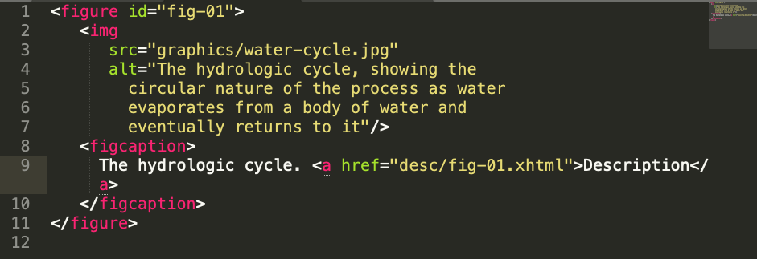
Long Description for complex images
Notes:
The following example uses simple hyperlinks to link to a description in a separate file.
In EPUB, when possible (i.e., when there are not too many images), the linked description should be located in a file by itself to avoid issues reaching the description (i.e., not all reading systems are able to locate the user properly when there are multiple descriptions). When there are many images, adding each description to a separate file can bloat the spine (i.e., every description file has to be listed).
An image could also be used to minimize the appearance of the link, but in EPUB some reading systems have issues with such links.
Despite its shortcomings, this is one of the most reliable techniques in EPUB.

Slide 38
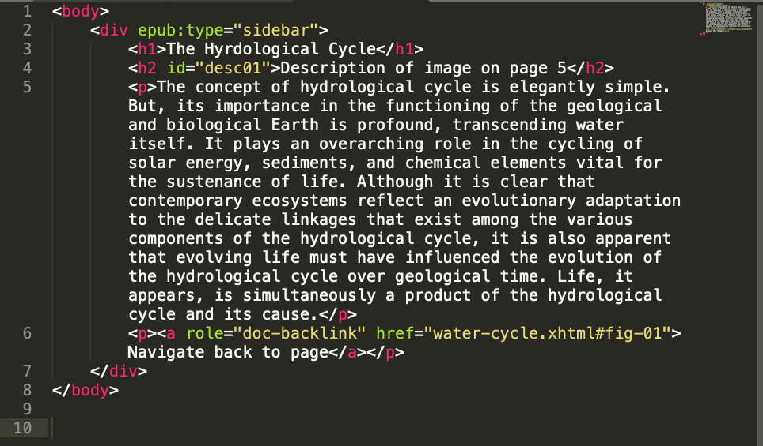
extended Description

Slide 39
Accessible Tables
Don’t use an image
Tables as series of lists
HTML Tables
Careful tagging, marking headers with <th> or <thead>
Use summary element

Slide 40
Accessible Tables
Don’t use an image where text will do.
Avoid setting text as image
Don’t use <table> for layout.
Present tabular materials differently
Careful tagging of HTML tables, marking headers with <th> or <thead>
Tables as series of lists
If it’s secondary material, not inline in the text, use <figure>

Slide 41
Bus Schedule

Slide 42
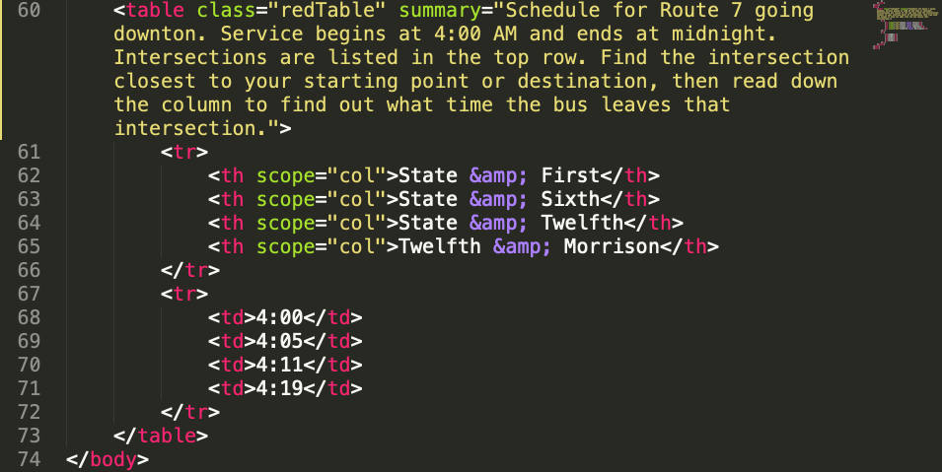
Bus Schedule Code

Slide 43
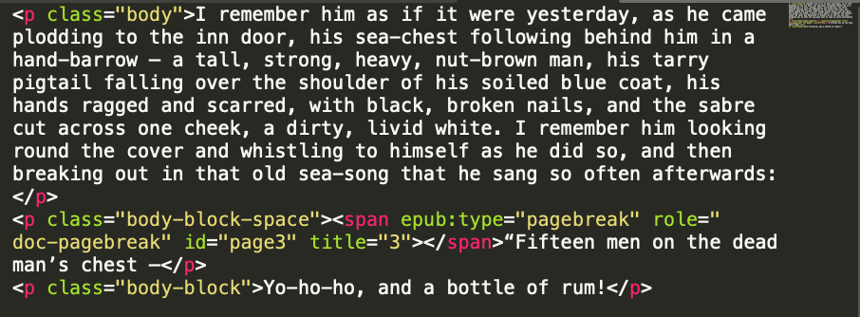
Page-List
Helps Navigation
Allows user of assistive technology to be on “the same page” as print readers.
Notes:
Kindle not really using it yet, but Books & ADE do

Slide 44
acquiring ebooks
Databases such as Haiti, BookShare, AccessText
Conversion from print collection, ILL
Request from vendor or publisher
Get EPUB 3.0 books if you can.
No reason to hold on to EPUB 2.0 books.
Fair use allows you to modify to make it more accessible.

Slide 45
Resources
Daisy Accessible Publishing Knowledge Base: http://kb.daisy.org/publishing
EPUB Secrets
#eprdctn on Twitter: https://twitter.com/hashtag/eprdctn
VitalSource Bookshelf

Slide 46
eBooks & Accessibility
https://bit.ly/ebooksA11y
\

